Slide 1
Library App
Members: Gal Erez, Eyal Ronen, Ran Shneor, Ariel Vaintraub

Slide 2
About the product
In this Library management app, you can see all information about your desired books.
You can register as a member in specific libraries, search for books via book name/author name/genre/library/any desired keywords, watch your loans history and loan books online.
This app is for anyone who love books, wants to be able to be a member in libraries and search and loan books.

Slide 3
features
Log-in and register window.
Watch loans history.
Faster usage with cookies.
Https.
RestAPI.
Search books via book name/author name/genre/library/any desired keywords.
Holding a files of books and searching for keywords in the files using TF-IDF algorithm and ZooKeeper.
Using NoSQL with MongoDB for faster usage and searching in the databases.

Slide 4

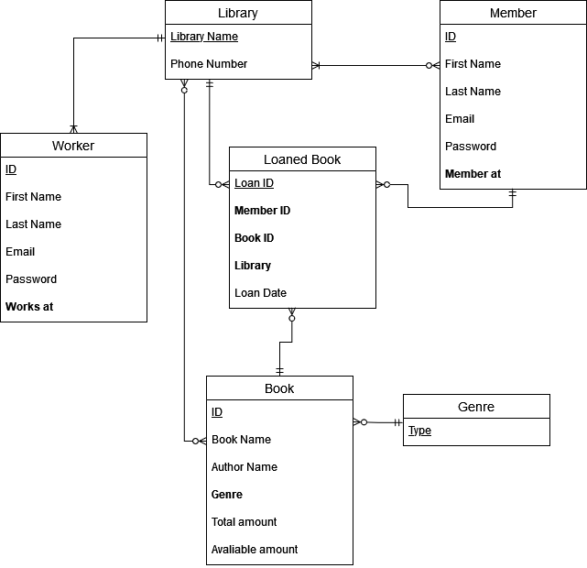
ERD

Slide 5
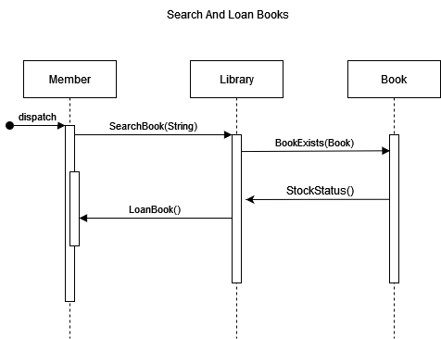
Sequence diagrams

Slide 6
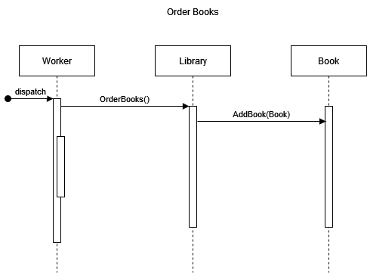
Sequence diagrams

Slide 7
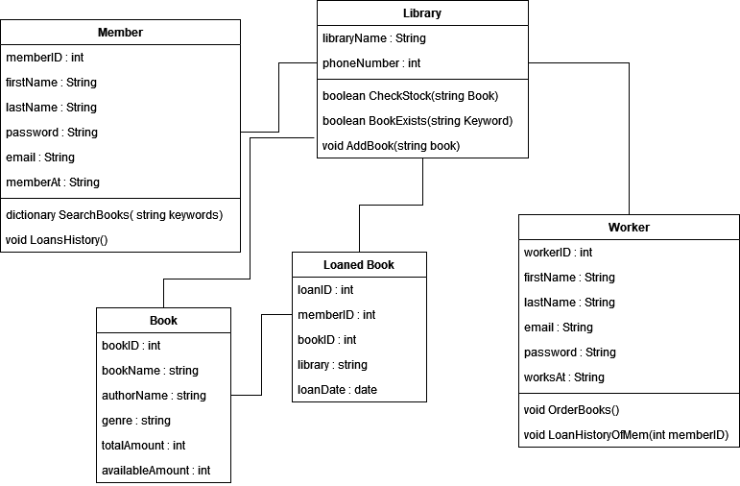
UML

Slide 8
FUTURE features
Read the first few pages online.
Books descriptions.
Author description.
Adding return dates, fines and the option to pay fines online.
Newsletter.
Add new workers.

Slide 9
ROLES IN THIS PROJECT

Slide 10
Questions?

